Slide 1
Title: P.T.A. Meeting
Date: 9/21/2023

Slide 2
Welcome to the First P.T.A. Meeting of the School Year!

Slide 3
I
AGENDA
1
Introductions: New PTA Board Members
2
Guest Speaker: The Honorable Kenneth Moore, Mayor of Bellerose Village
3
School Updates: Principal Dekams & Vice Principal Stegmeier
4
Raffle Drawing: Enter to win cool prizes!

Slide 4
01
Introductions: Welcome to the new PTA Board Members!

Slide 5
BOARD MEMBERS
Susan Saint-Joy - President
Shana Myones – 1st Vice President
Christina Donello – 2nd Vice President
Kate Trainor – Treasurer
Pauline Ferrante – Corresponding Secretary
Jacqueline Payoute – Recording Secretary

Slide 7
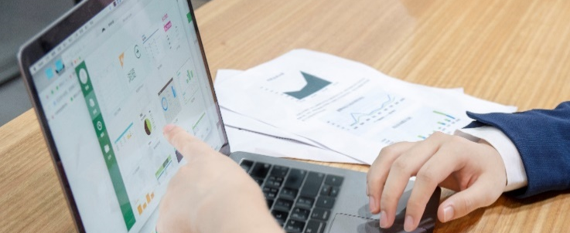
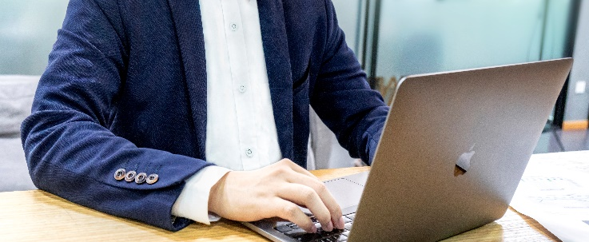

Slide 8
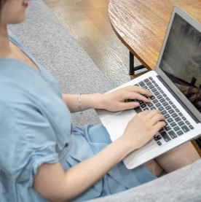

Slide 10
02
Guest Speaker: The Honorable Kenneth Moore, Mayor of Bellerose Village

Slide 11
01
02

Slide 12
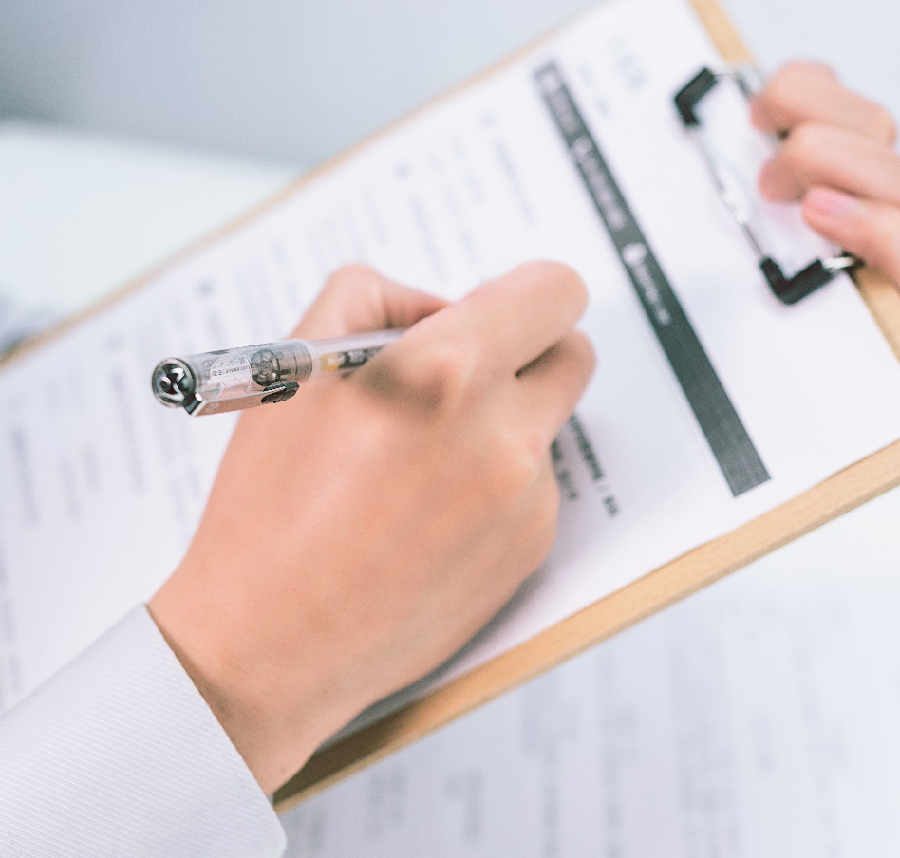

Slide 14
01
02
03

Slide 15
03
School Updates: Principal Dekams & Vice Principal Stegmeier

Slide 16
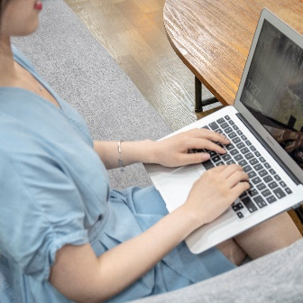
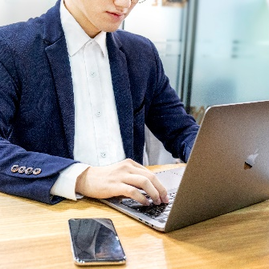

Slide 17
120
275
33

Slide 18
01
02
03

Slide 19
01
02
03
04
05

Slide 20
04
Raffle Drawing: Enter to win cool prizes!

Slide 21
Raffle Prize

Slide 23
Raffle Prize

Slide 24
12345678910
12345678

Slide 25
Summer Certificate of Appreciation Goes to: Allison & Cheryl

Slide 26
Thank You!

